Slide 1
Reversible Inhibition, pH & Temperature Effect

Slide 2
Enzyme Inhibition
Enzyme can be inhibited by inhibitors. Inhibitors are tools to scientists to understand enzymes. Inhibitors are also in many cases pharmaceutical reagents against diseases;
Inhibitors inhibit enzyme function by binding with enzymes. The binding reaction can be either reversible or irreversible;
Reversible inhibitors associate with enzymes through non-covalent interactions. Reversible inhibitors include three kinds:
  Competitive inhibitors;
  Un-competitive inhibitors;
  Mixed inhibitors (Non-competitive inhibitors)
Irreversible inhibitors associate with enzymes through covalent interactions. Thus the consequences of irreversible inhibitors is to decrease in the concentration of active enzymes.

Slide 3
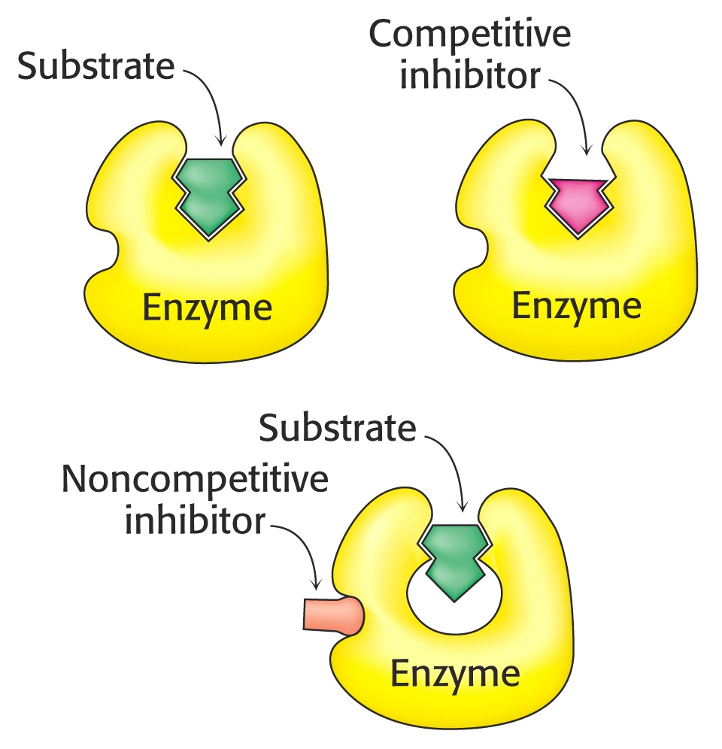
Enzyme Inhibition
Competitive vs. noncompetitive

Slide 4
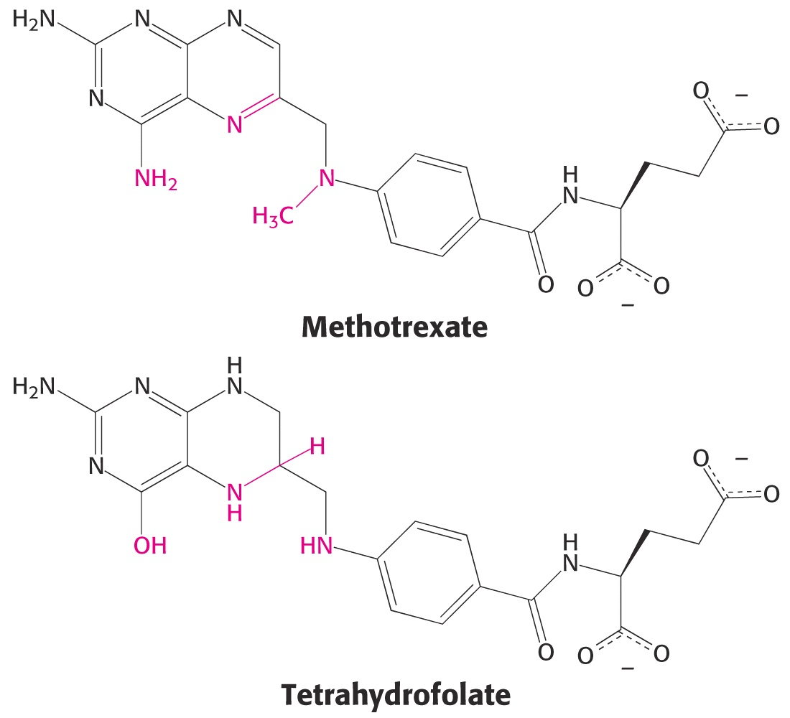
Competitive Inhibitors Are often Structurally Similar to Substrates for the Enzyme

Slide 5
Competitive Inhibitors
k₁
k₂
K₋₁
K_{m} increases
v_{max} unchanged
K_{I}
v
+inhibitor
1/v
v_{max}
Slope=K_{m}/v_{max}
Slope= K_{m}(1+[I]/K_{I})/v_{max}
K_{m}(1+[I]/K_{I})
K_{m}
-1/K_{m}
1/v_{max}
[S]
1/[S]
-1/(K_{m}(1+[I]/K_{I}))

Slide 6
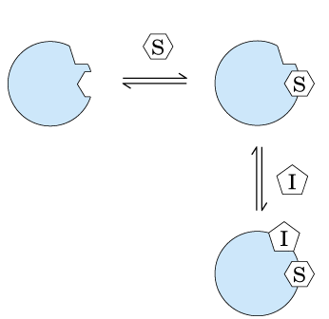
Uncompetitive Inhibitors
k₁
k₂
k₋₁
K_{m} decreases
v_{max} decreases
Slope unchanged
K_{I’}
+inhibitor
v
1/v
v_{max}
(1+ K_{I}/[I])/V_{max}
Slope=K_{m}/v_{max}
V_{max}/(1+K_{I}/[I])
Slope= K_{m}/v_{max}
-1/K_{m}
1/v_{max}
K_{m}/(1+ K_{I}/[I])
K_{m}
[S]
-(1+ K_{I}/[I])/K_{m}
1/[S]

Slide 7
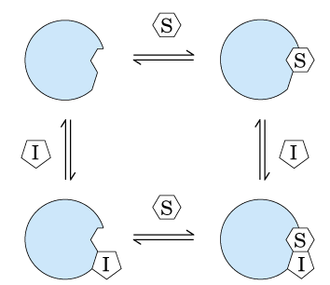
Mixed Inhibitions
+inhibitor
1/v
Slope=K_{m}/v_{max}
-1/K_{m}
1/v_{max}
1/[S]
+inhibitor
1/v
Slope=K_{m}/v_{max}
-1/K_{m}
1/v_{max}
1/[S]

Slide 8
Pure Noncompetitive Inhibitors
k₁
k₂
k₋₁
K_{I}
K_{I’}
K_{m} unchanged
v_{max} decreases
v
+inhibitor
1/v
v_{max}
Slope=K_{m}/v_{max}
(1+[I]/K_{I})/V_{max}
V_{max}/(1+[I]/K_{I})
Slope= K_{m}(1+[I]/K_{I})/v_{max}
-1/K_{m}
1/v_{max}
[S]
K_{m}
K_{m}
1/[S]

Slide 9
Summary of Inhibitors
Competitive inhibition - inhibitor (I) binds only to E, not to ES
Noncompetitive inhibition - inhibitor (I) binds either to E and/or to ES
Uncompetitive inhibition - inhibitor (I) binds only to ES, not to E. This is a hypothetical case that has never been documented for a real enzyme, but which makes a useful contrast to competitive inhibition.
Mixed inhibition-when the dissociation constants of (I) to E and ES are different. The inhibition is mixed.

Slide 10
Competitive Inhibition
k₁
k₋₁
k₂
E + S ES E + P
+
I
EI
K₁
Net Effect:
Increased value of K’_{m,app} resulting in a reduced reaction rate
Can be overcome with high [S]

Slide 11
Noncompetitive Inhibition
K_{m}’
E + S ES E + P
k₂
+
I
EI +S
+
I
ESI
K_{I}
K_{m}’
Net Effect:
Reduced V_{m}
Can be overcome by adding other reagents to block binding of inhibitor to enzyme
K’_{m} is increased if ESI can form product

Slide 12
Uncompetitive Inhibition
K_{m}’
E + S ES E + P
k₂
+
I
ESI
K_{I}
Net effect:
Reduction in both V_{m} and K’_{m}
Reduction in reaction rate

Slide 13
Substrate Inhibition
Caused by high substrate concentrations
K_{m}’
E + S ES E + P
k₂
+
S
ES₂
K_{S1}

Slide 14
Substrate Inhibition
At low substrate concentrations [S]²/K_{s1}<<1 and inhibition is not observed
Plot of 1/v vs. 1/[S] gives a line
  Slope = K’_{m}/V_{m}
  Intercept = 1/V_{m}

Slide 15
Substrate Inhibition
At high substrate concentrations, K’_{m}/[S]<<1, and inhibition is dominant
Plot of 1/v vs. [S] gives a straight line
  Slope = 1/K_{S1} · V_{m}
  Intercept = 1/V_{m}

Slide 16
1/V
I>0
1/V
I>0
I=0
I=0
1/V_{m}
1/V_{m,app}
1/V_{m}
-1/K_{m}
-1/K_{m,app}
1/[S]
-1/K_{m}
1/[S]
-1/K_{m,app}
Competitive
Uncompetitive
1/V
1/V
I>0
I=0
1/V_{m,app}
1/V_{m}
1/V_{m}
-1/K_{m}
1/[S]
-1/K_{m}
1/[S]
Non-Competitive
Substrate Inhibition

Slide 17
Effects of pH
Presence of ionic groups that must be in acid or base form to function
  Changes in pH can change activity
Changes in pH can alter the 3-D shape
Optimum pH can be determined experimentally

Slide 18
Effect of pH

Slide 19
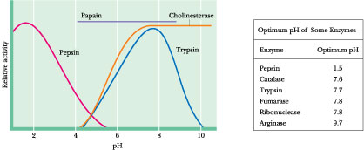
Effect of pH on Enzymatic Activity
Enzyme-substrate recognition and the catalytic events that ensue are greatly dependent on pH. An enzyme possesses an array of ionizable side chains and prosthetic groups that not only determine its secondary and tertiary structure but may also be intimately involved in its active site.
Further, the substrate itself often has ionizing groups, and one or another of the ionic forms may preferentially interact with the enzyme.

Slide 20
Effects of Temperature
Reaction rate increases with temperature up to a limit
Above a certain temperature, activity decreases with temperature due to denaturation
  Denaturation is much faster than activation
Rate varies according to the Arrhenius equation
Where E_{a} is the activation energy (kcal/mol)
[E] is active enzyme concentration

Slide 21
Temperature Dependence

Slide 22
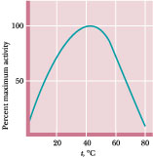
Effect of Temperature on Enzymatic Activity
Most enzymatic reactions double in rate for every 10C rise in temperature (that is, Q₁₀ = 2, where Q₁₀ is defined as the ratio of activities at two temperatures 10° apart) as long as the enzyme is stable and fully active.
Not all enzymes are quite so thermally labile. For example, the enzymes of thermophilic bacteria (thermophilic = “heat-loving”) found in geothermal springs retain full activity at temperatures in excess of 85C

